Slide 1


UNIVERSITY INSTITUTE OF ENGINEERING
Academic Unit V
Bachelor of Engineering (Computer Science & Engineering)
Biology For Engineers
23SZT-148
Biology for Engineers
DISCOVER . LEARN . EMPOWER

Slide 2
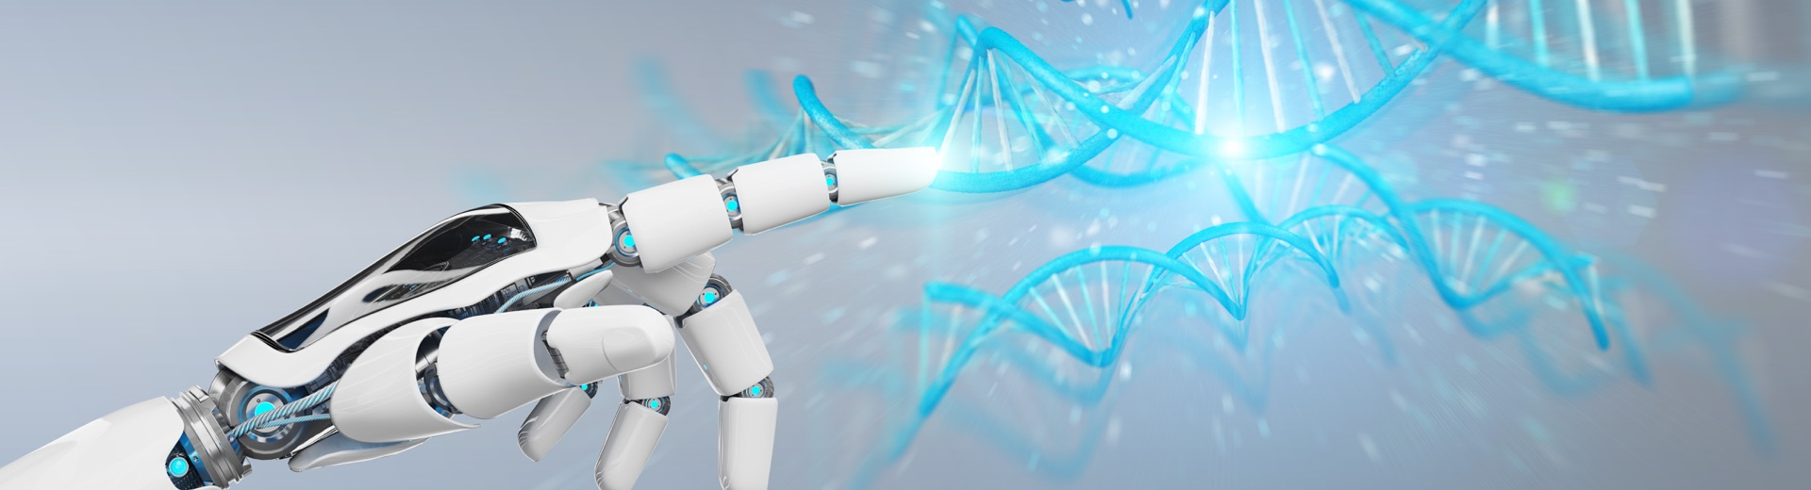
INTRODUCTION
Course Objective
This subject is designed to impart fundamental knowledge on basic of genetics and emerging fields of biology like biomedical recording system and medical instrumentation.
It is designed to impart knowledge that how to apply basics of biology in engineering.
https://www.uic.es/sites/default/files/uic-grau-bioenginyeria-hero-header_1.jpg
Biology for Engineers

Slide 3


INTRODUCTION
Space for visual (size 24)
Course Outcome
CO Number | Title | Level
CO1 | Identify the biological concepts from an engineering perspective. | knowledge
CO2 | Development of artificial systems mimicking human action. | Understand
CO3 | Explain the basic of genetics that helps to identify and formulate problems | Analyze
CO4 | Apply knowledge of measurement system, biomedical recording system and biosensors to excel in areas such as entrepreneurship, medicine, government, and education. | Apply
CO5 | Integrate biological principles for developing next generation technologies, | Create
Will be covered in this lecture
https://specials-images.forbesimg.com/imageserve/1034901762/960x0.jpg?fit=scale
Biology for Engineers

Slide 4
SYLLABUS
Unit-1 | Importance of Biology In Engineering | Contact Hours: 15
Chapter 1 Significance of Biology in Engineering Chapter 2 Genetics | Introduction: Fundamental Differences between Science and engineering by drawing a comparison between eye and camera, Bird flying and aircraft. Significance of Biology in Engineering, Discuss how biological observations of 18th Century that lead to major discoveries, Examples from Brownian motion and the origin of thermodynamics by referring to the original observation of Robert and Julius Mayor. Genetics: Mendel’s laws, Concept of segregation and independent assortment, concept of allele, gene mapping, Gene interaction, Epitasis, Meiosis and Mitosis as a part of genetics. Mechanism of how genetic material passes from parent to offspring. Concepts of recessiveness and dominance. Concept of mapping of phenotype to Genes, single gene disorders in humans, concept of complementation using human genetics.
Biology for Engineers

Slide 5


COMPARISON BETWEEN
BIRD FLYING AND AIRCRAFT

Slide 6
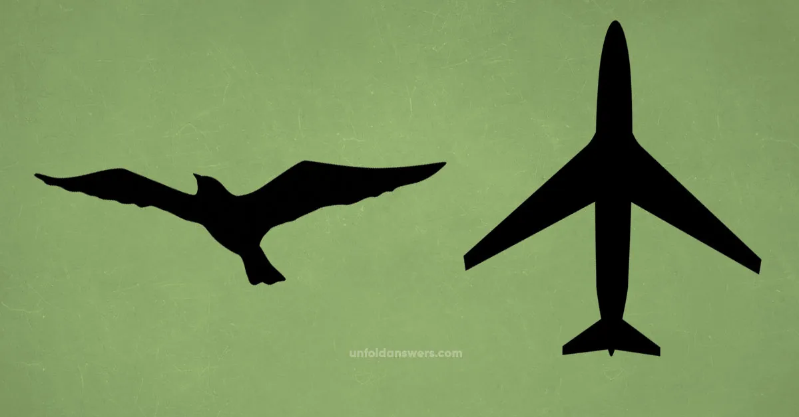
Birds and aircraft are amazing because of their common attribute, flight
Biology for Engineers

Slide 7
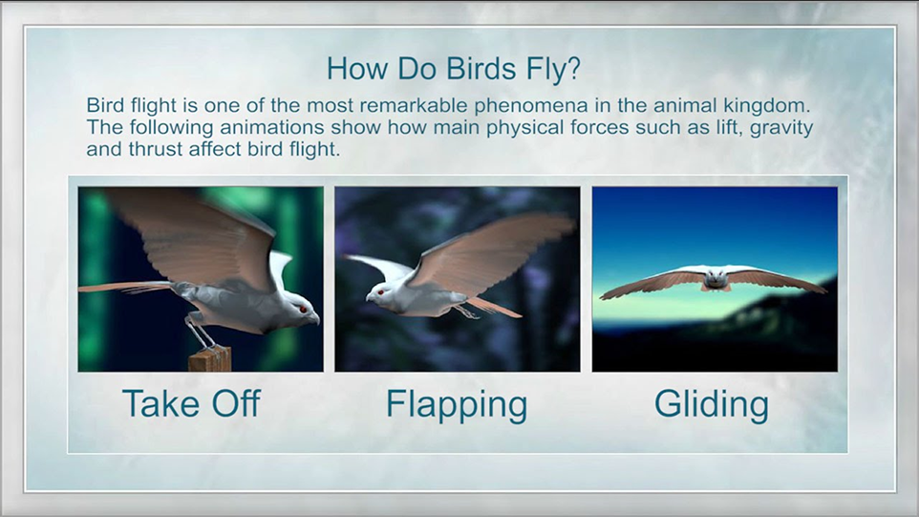
Biology for Engineers
https://i.ytimg.com/vi/hmN11jZd3bU/maxresdefault.jpg

Slide 8
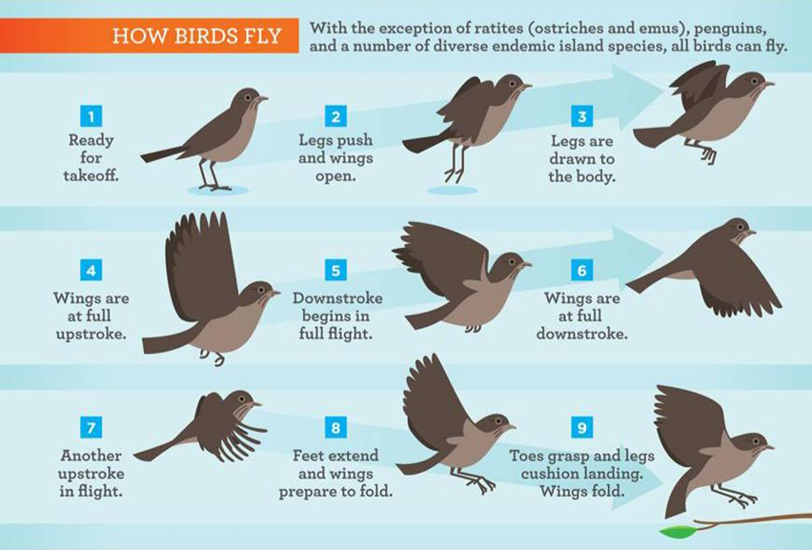
Biology for Engineers
https://i.ytimg.com/vi/hmN11jZd3bU/maxresdefault.jpg

Slide 9
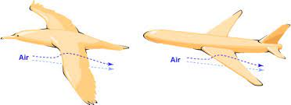
Birds fly so effortlessly because of the adaptations that they have
  Birds have streamlined shapes so that when they are in flight the air can flow on their surface smoothly
  Birds have smooth and sometimes glossy surface. Birds groom their feathers with their beaks to makes sure that their body is smooth as they fly
Engineers used the shape of the birds as inspiration to model the planes
  Most airplanes have a streamlined shape so that they do not face air resistance when they are in motion
  Airplanes also have polished surfaces, and this prevents air resistance
Biology for Engineers

Slide 10
Similarities between birds and aircraft
Humans must have gained the inspiration of flight from birds, since birds were the only living creatures (putting aside the insects) gifted with the skill of flight.
The early days aircraft prototypes contained movable wings as birds. We can be much inclined to this ‘bird inspired airplane’ hypothesis even more enlisting similarities between aircraft and birds.
So here are some similarities between birds and aircraft.
Biology for Engineers

Slide 11
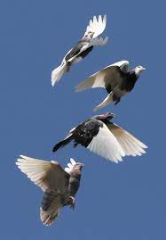
Similarities between birds and aircraft
The take off (lift)
  Birds take off in various ways
    Some birds run just before flight to create an air lift (upward force), some flap their wings and some just jump off and glide.
    The flapping of their wings to swipe the air below as well as their speed during the run results the pressure below the birds to be higher and that of above to be lower. So, this creates an air lift which pushes the birds upward.
  The similar kind of thing occur in an aircraft
    In helicopter, the rotor pushes the air downwards as do wings in a bird.
    Also in airplane, the speed in the runway creates the pressure difference, which is responsible for creating the lift enough for flight. The structural design is actually more important for the lift.
Biology for Engineers

Slide 12
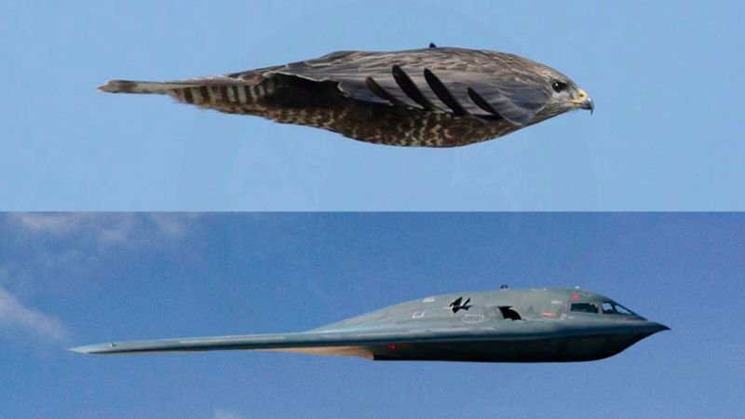
Similarities between birds and aircraft
The shape and structure
  The structure of birds and aircraft is quite similar.
  Both have streamlined body structure which is necessary for flight.
  The body is made up of light materials in case of aircraft whereas birds have light bones and feathers in their body.
  The wings make birds and aircraft even closer, as both of them use wings for flight as well as the shape of it.
  Also, the front part of aircraft is pointed as the front part of bird (beak). This is responsible for creating them more aerodynamic and helps in forward movement by sweeping the air.
Biology for Engineers

Slide 13
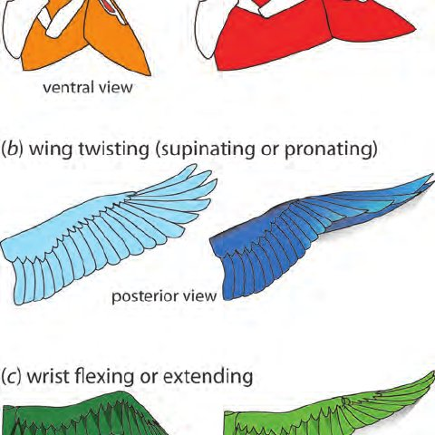
Similarities between birds and aircraft
Flight techniques – Gliding
  There are various flight techniques that aircraft practice as the birds do. Both birds and winged aircraft can glide in the air for a longer distance.
  They can also use gliding as an energy efficient mode. During gliding almost no energy is spent by birds whereas the aircraft also use minimum of energy.
Biology for Engineers

Slide 14
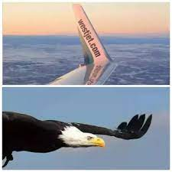
Similarities between birds and aircraft
Movement in the air
  Aircraft use different movable parts in their wings and tails to simply change direction so as to direct the movement.
  They control horizontal and vertical movement as well as tilting. Likewise the tail of birds are responsible for entire movement since both parts of birds are completely movable unlike aircraft.
Biology for Engineers

Slide 15
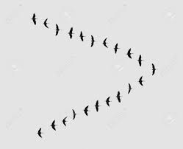
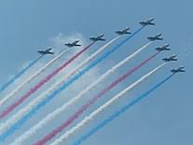
Similarities between birds and aircraft
Birds use a concept where they fly in a V shape when they are in a flock. This mode of flying has enabled birds to travel greater distances (adds more energy).
The birds keep changing positions and rotate their place in the stack, and this helps them go for long distances without tiring.
There are some researchers who utilized this trait and concluded that if jets use the same trait, they can save on fuel.
They purported that if jets fly in a V-shape and alternate their positions, they would manage to save their fuel up to 15%.
Biology for Engineers

Slide 16
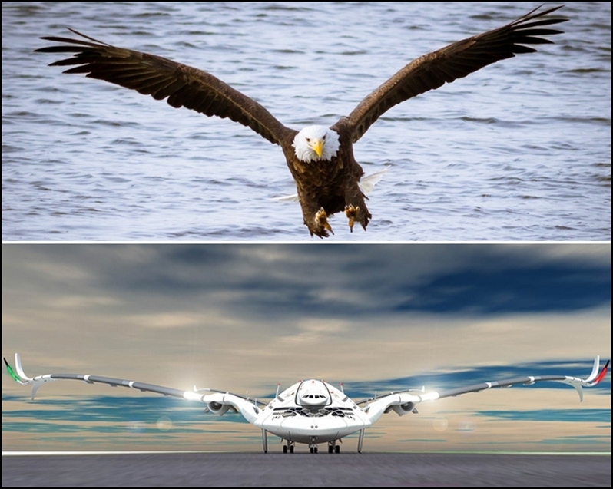
Similarities between birds and aircraft
Landing
  Aircraft and birds both gain or lose elevation with the variation of the drag force that acts downward and the lift force that acts upwards.
  Both of them take control during the landing process by the use of their motion controllers.
  Birds usually generate a resistance by flapping their wings while the aircraft move the ailerons, elevator and apply brakes.
Biology for Engineers

Slide 17
Apart from these similarities, both are different in terms of many other things.
So, the early bird inspired aircraft were more bird like than these modern evolved aircraft that we observe today.
Biology for Engineers

Slide 18
APPLICATIONS
The study of biology for engineers will pave way for advance studies in the bioengineering.
It will help in advance research area.
It will help in understanding different biological processes.
Biology for Engineers

Slide 19
CONCLUSION
Biological engineering, or bioengineering/bio-engineering, is the application of principles of biology and the tools of engineering to create usable, economically viable products.
We need biology to find solutions to challenges, that face mankind.
Biology is used in different engineering branches
Biology for Engineers

Slide 20
BIO-INSPIRED TECHNOLOGIES
Biology for Engineers

Slide 21
Biologically-inspired design (or BID) has become an important and increasingly wide-spread movement in design for environmentally-conscious sustainable development
Aircraft wing design and flight techniques are being inspired by birds and bats.
Biorobots based on the physiology and methods of locomotion of animals include BionicKangaroo which moves like a kangaroo, saving energy from one jump and transferring it to its next jump.
Techniques used in camera are inspired by human eye.
Suction nozzle of vacuum cleaner is inspired by proboscis of flies (elongated sucking mouthpart).
Biology for Engineers

Slide 22
Summary
Biological engineering, or bioengineering/bio-engineering, is the application of principles of biology and the tools of engineering to create usable, tangible, economically viable products.
We need biology to find the solutions of different challenges face by the mankind.
There are many technologies in the history that are inspired by biology.
Biology for Engineers

Slide 23
REFERENCES
Video link: https://www.digimat.in/nptel/courses/video/121106008/L01.html
https://youtu.be/ld3A065dELc
https://nptel.ac.in/courses/121/106/121106008/
https://www.utoledo.edu/engineering/bioengineering/undergrad/prospective/whatisbioe.html#:~:text=Bioengineering%20is%20the%20application%20of,health%20care%20and%20other%20fields.
https://i.pinimg.com/originals/68/c9/30/68c930e95113ceb2e3dfc9de2f164680.png
https://youtu.be/FBUpnG1G4yQ
Biology for Engineers

Slide 24

Biology for Engineers

